Slide 1
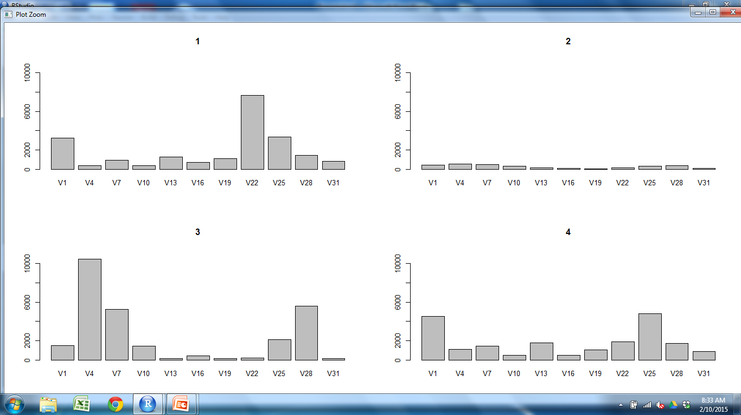
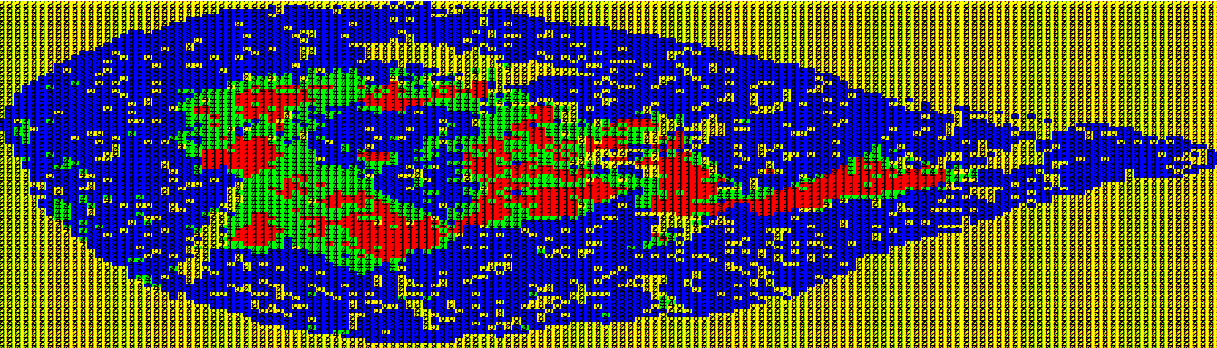
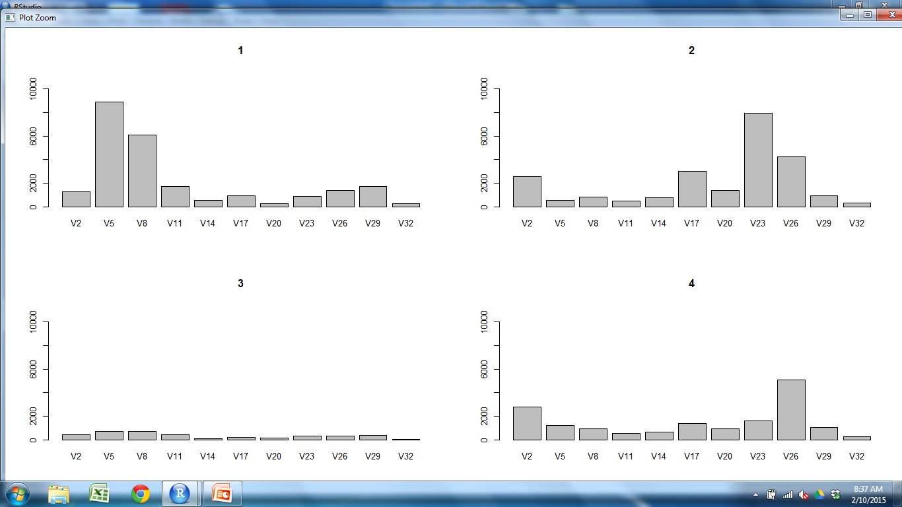
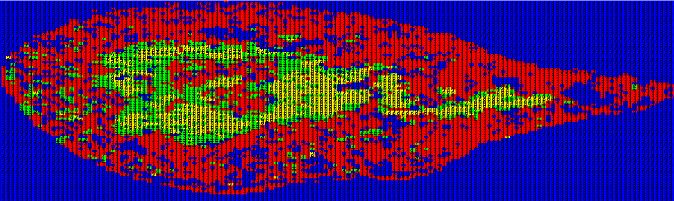
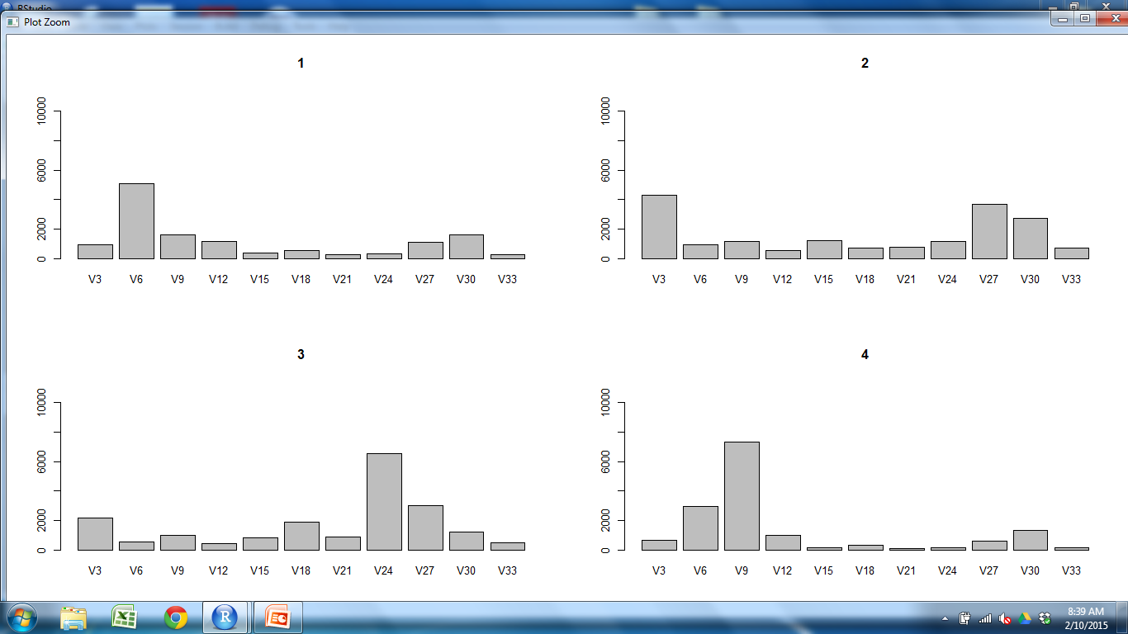
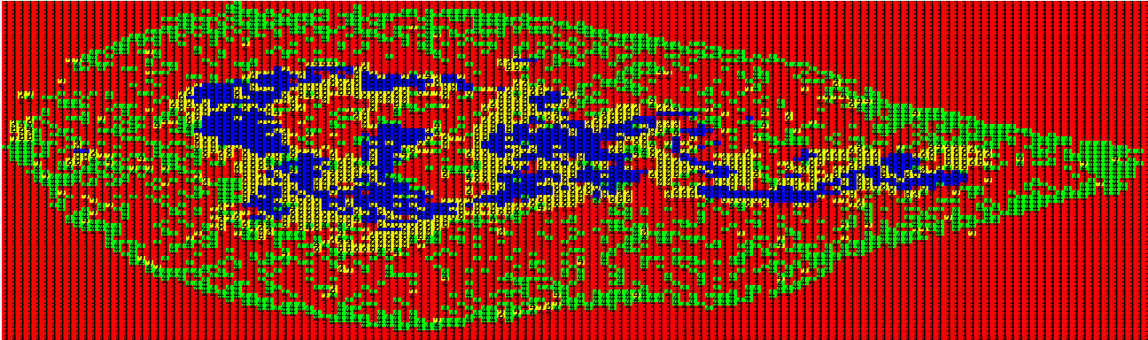
CD11c CD25 CD31 CD205 Claud5 Claud34 Foxp3 K5 K14 PDGFRb UEA1

Slide 2
CD11c CD25 CD31 CD205 Claud5 Claud34 Foxp3 K5 K14 PDGFRb UEA1

Slide 3
CD11c CD25 CD31 CD205 Claud5 Claud34 Foxp3 K5 K14 PDGFRb UEA1

Slide 4
CD11c CD25 CD31 CD205 Claud5 Claud34 Foxp3 K5 K14 PDGFRb UEA1

Slide 5
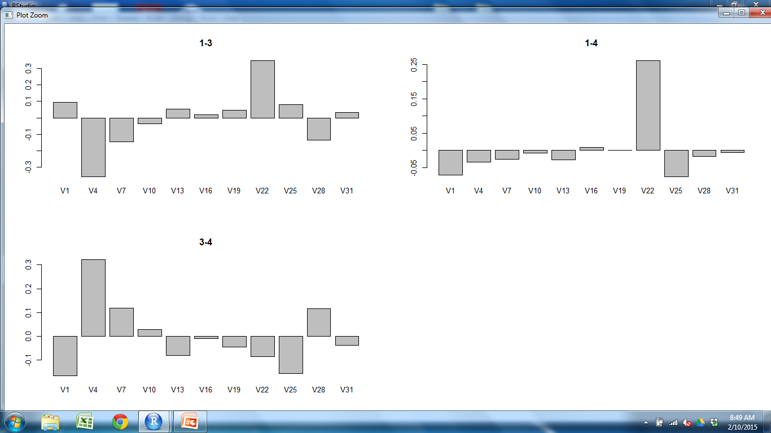
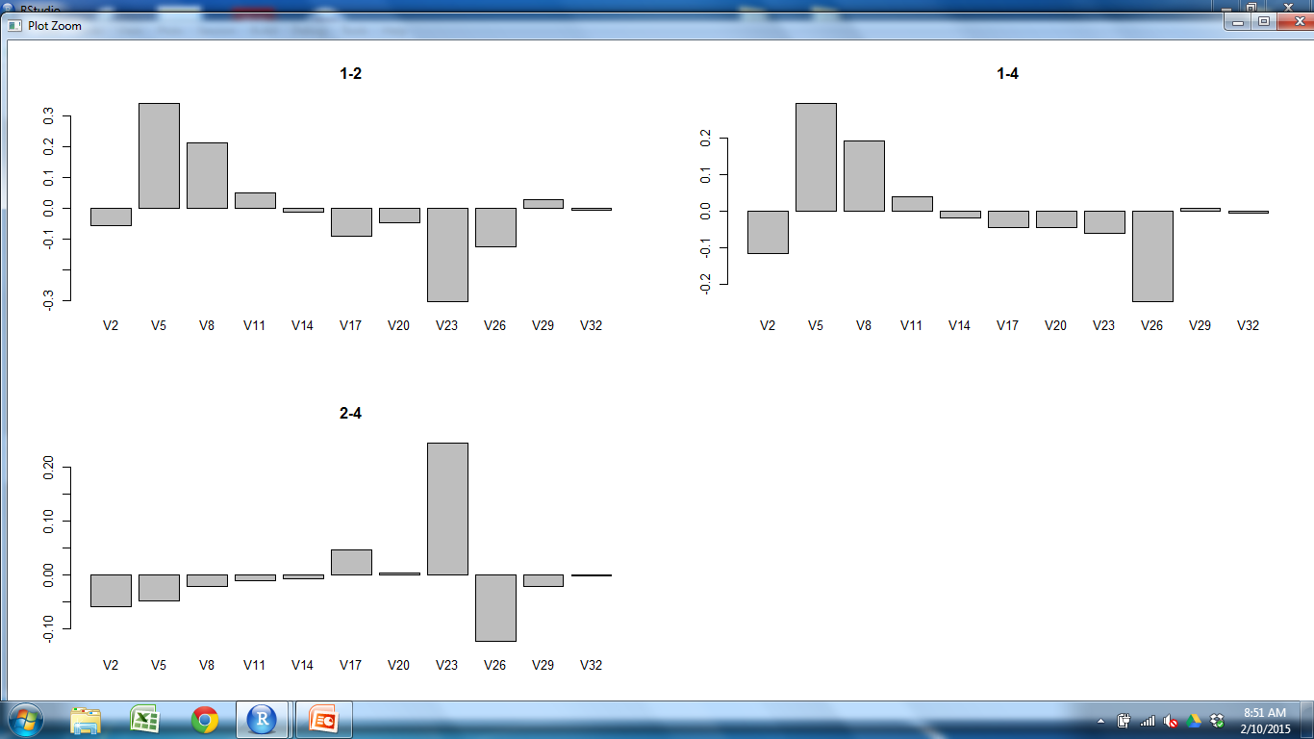
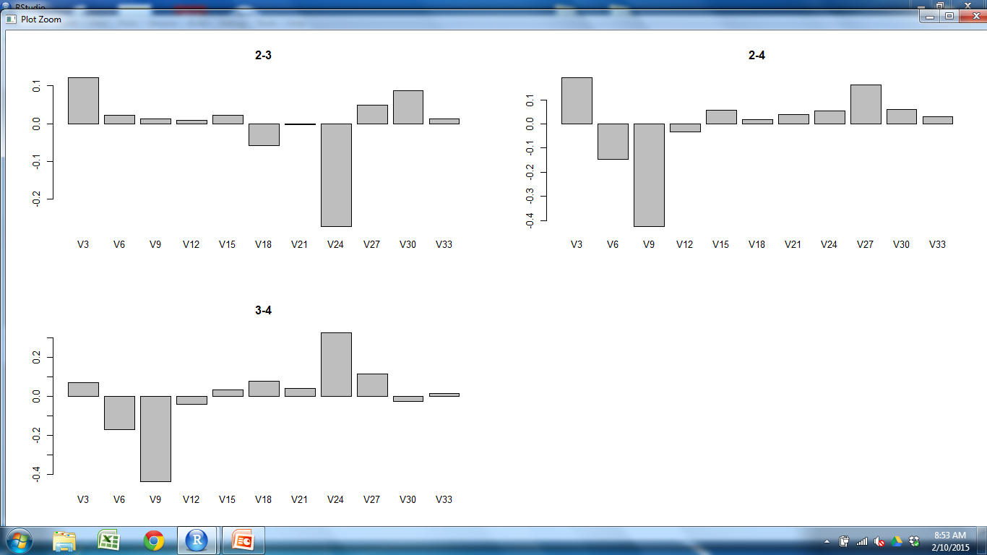
CD11c CD25 CD31 CD205 Claud5 Claud34 Foxp3 K5 K14 PDGFRb UEA1

Slide 6
CD11c CD25 CD31 CD205 Claud5 Claud34 Foxp3 K5 K14 PDGFRb UEA1

Slide 7
CD11c CD25 CD31 CD205 Claud5 Claud34 Foxp3 K5 K14 PDGFRb UEA1

Slide 8
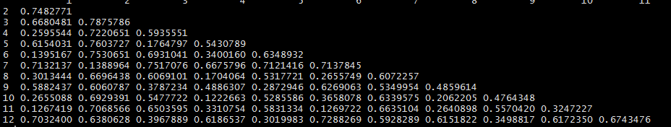
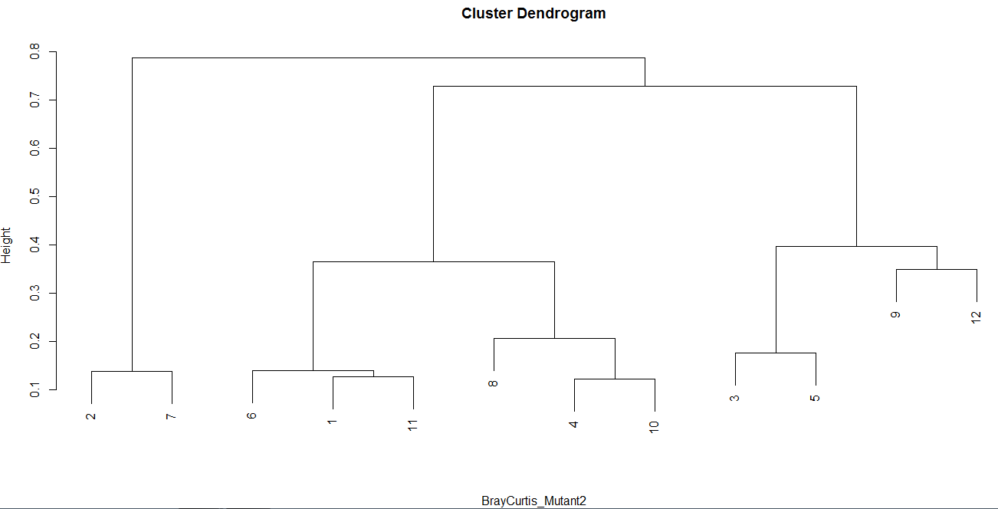
M2 Outer Cortex M1 Cortex M2 Outer M1 Outer M1 M2
Outer
Cortex
M1
Cortex
M2
Outer
M1
Outer
M1
M2
Cortex
S1Outer S2Outer S2M2 S1M2 S3M2 S2M1 S1M1 S3M1 S1Cortex S2Cortex S3Outer S3Cortex

